Slide 1
STAT 7900: Special Topic:
Causal Analysis
Instructor
Dhrubajyoti Ghosh
KENNESAW STATE UNIVERSITY
STAT 7900

Slide 2
Recap: the causal question
Descriptive: how do outcomes differ across observed groups?
Predictive: who is likely to have the outcome?
Causal: what would happen if we assigned an intervention?
Specify population, treatment, comparator, outcome, and time horizon.
Example: does Drug A lower four-week blood pressure in eligible adults?

Slide 3
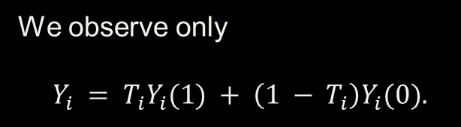
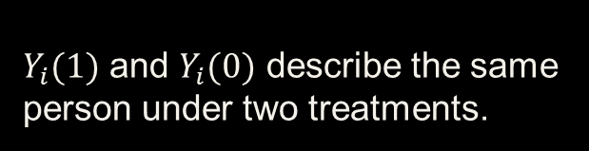
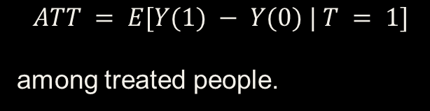
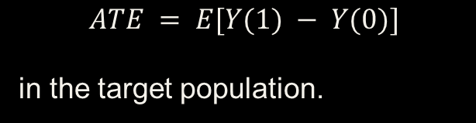
Potential outcomes and the target effect
$Y_{i}(1)$ and $Y_{i}(0)$ describe the same person under two treatments.
We observe only
$$Y_{i} = T_{i}Y_{i}(1) + \left(1 − T_{i}\right)Y_{i}(0).$$
$$ATE = E[Y(1) − Y(0)]$$
in the target population.
$$ATT = E[Y(1) − Y(0) | T = 1]$$
among treated people.
$E[Y | T = 1] − E[Y | T = 0]$ can differ from the ATE.

Slide 4

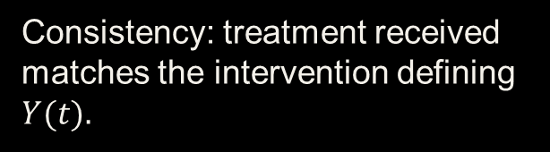

Four assumptions for causal interpretation
Consistency: treatment received matches the intervention defining $Y(t).$
Exchangeability:
$$\{Y(1), Y(0)\} ⟂ T | X.$$
Positivity: both treatments occur within relevant $X$ profiles.
No interference: another person’s treatment does not change my outcome.
Measured covariate balance alone cannot verify all four assumptions.

Slide 5
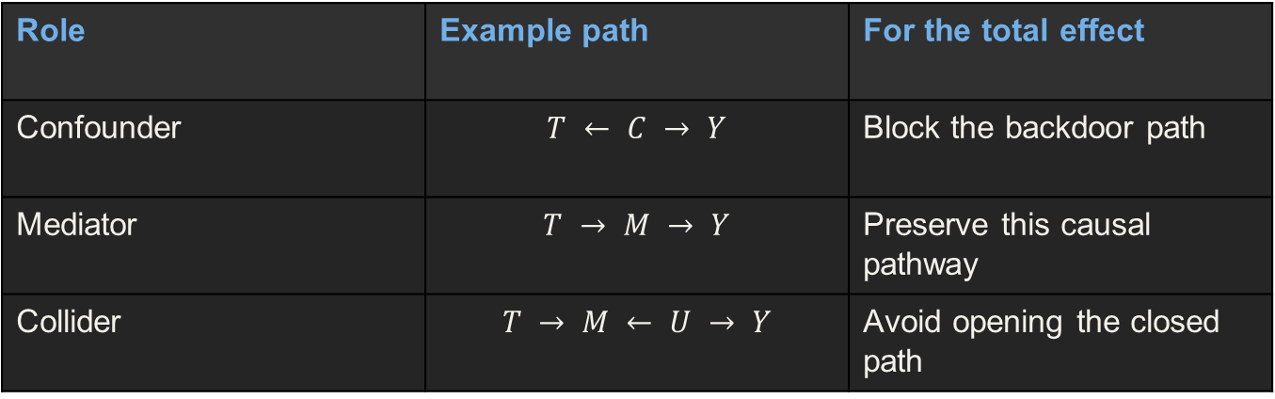
Adjustment depends on the causal graph
Role | Example path | For the total effect
Confounder | $$T ← C → Y$$ | Block the backdoor path
Mediator | $$T → M → Y$$ | Preserve this causal pathway
Collider | $$T → M ← U → Y$$ | Avoid opening the closed path
A variable’s role depends on the path and the estimand.

Slide 6
Identification through the g-formula
$$E[Y(t)] = Eₓ\{E[Y | T = t, X]\}.$$
Within each X stratum, use comparable observed units to estimate the treatment-specific mean.
Average those means over one common target distribution of X.
The DAG and assumptions justify this replacement of missing counterfactual means.
Identification gives an observed-data formula. Estimation computes it.

Slide 7
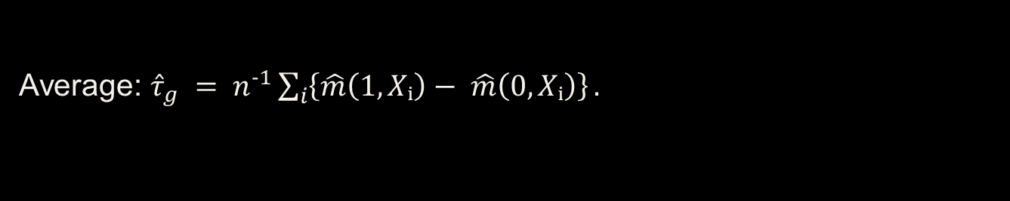
g-computation and the treatment coefficient
Fit $m(t,x) = E[Y | T = t, X = x].$
Predict $\hat{m}(1,X_{i})$ and $\hat{m}(0,X_{i})$ for each person.
Average: ${\hat{τ}}_{g} = n^{−1}\sum_{i}{\left\{\hat{m}\left(1,Xᵢ\right)− \hat{m}\left(0,Xᵢ\right)\right\}}.$
With $T × X$ interaction, the contrast varies with X.
For $m(t,x) =β_{0} + β_{T}t + β_{X}x + β_{TX}tx, ATE = β_{T} + β_{TX}E[X].$

Slide 8
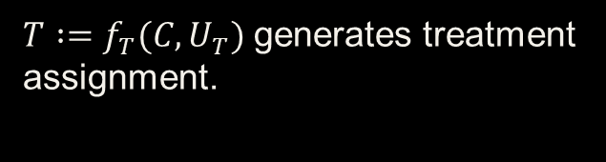
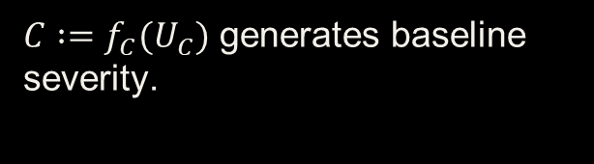
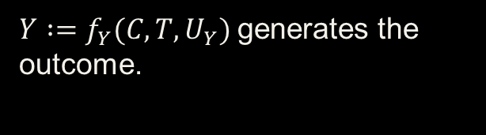
Structural causal models
$C :=f_{C}(U_{C})$ generates baseline severity.
$T :=f_{T}(C,U_{T})$ generates treatment assignment.
$Y :=f_{Y}(C,T,U_{Y})$generates the outcome.
The structural rules state how the system responds to interventions.
A DAG gives the causal structure. An SCM also specifies the mechanisms.

Slide 9
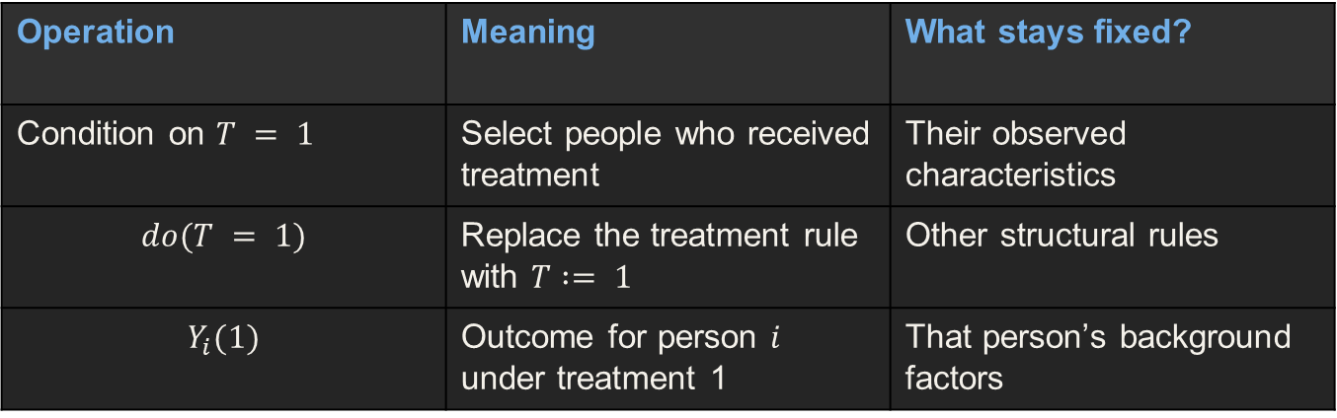
Conditioning, intervention, counterfactual
Operation | Meaning | What stays fixed?
Condition on $T = 1$ | Select people who received treatment | Their observed characteristics
$$do(T = 1)$$ | Replace the treatment rule with $T := 1$ | Other structural rules
$$Y_{i}(1)$$ | Outcome for person $i$ under treatment 1 | That person’s background factors
Intervening changes assignment. Conditioning selects an observed subgroup.

Slide 10
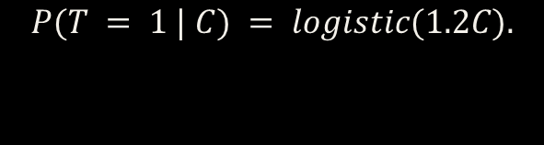
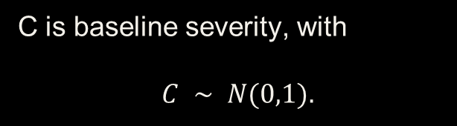
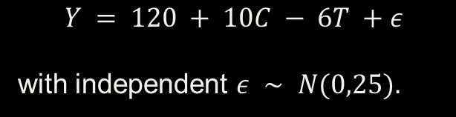
Simulation: a known causal world
C is baseline severity, with
$$C ∼ N(0,1).$$
$$P(T = 1 | C) = logistic(1.2C).$$
$$Y = 120 + 10C − 6T +ε$$
with independent $ε ∼ N(0,25).$
Higher severity increases treatment probability and blood pressure.
True effect: $Y_{i}(1) − Y_{i}(0) = −6 mmHg$for every person.

Slide 11
Simulation: generate and compare
set.seed(7900)
n <- 5000
C <- rnorm(n)
T <- rbinom(n, 1, plogis(1.2 * C))
eps <- rnorm(n, sd = 5)
Y <- 120 + 10 * C - 6 * T + eps
dat <- data.frame(C, T, Y)
coef(lm(Y ~ T, data = dat))["T"]
coef(lm(Y ~ T + C, data = dat))["T"]
Predict the crude and adjusted results before running the code.

Slide 12
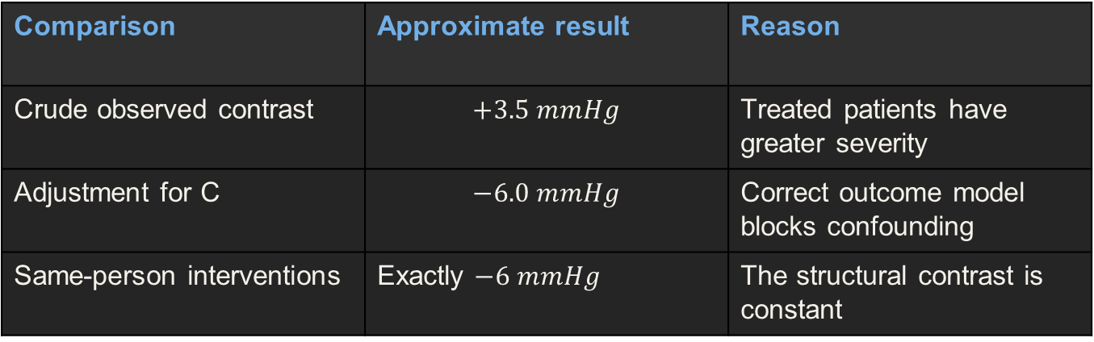
Simulation: association versus intervention
Comparison | Approximate result | Reason
Crude observed contrast | $$+3.5 mmHg$$ | Treated patients have greater severity
Adjustment for C | $$−6.0 mmHg$$ | Correct outcome model blocks confounding
Same-person interventions | Exactly $−6 mmHg$ | The structural contrast is constant
$Y₁ = 120 + 10C − 6 +ε$ and $Y₀ = 120 + 10C +ε$.

Slide 13
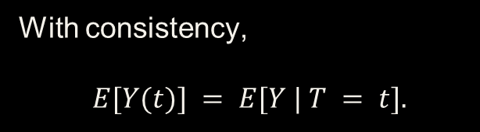
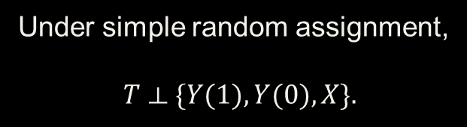
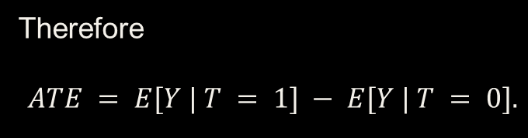
Randomization and Identification
Under simple random assignment,
$$T ⟂ \{Y(1), Y(0), X\}.$$
With consistency,
$$E[Y(t)] = E[Y | T = t].$$
Therefore
$$ATE = E[Y | T = 1] − E[Y | T = 0].$$
Randomization balances baseline causes in expectation, not exactly in every sample.
Randomization identifies the assignment effect when outcomes and design support it.

Slide 14
Randomized designs and analysis
Design | Assignment mechanism | Analysis implication
Complete / Bernoulli | Individuals receive random assignments | Respect fixed versus random arm sizes
Blocked / paired | Randomize within strata or pairs | Account for strata or pairs
Cluster | Randomize clinics or other groups | Account for within-cluster dependence
The randomization unit determines how we quantify uncertainty.

Slide 15
Estimation and uncertainty in an RCT
Difference in means: $\hat{τ} ={\overline{Y}}_{1}−{\overline{Y}}_{0}.$
Independent-arm SE: $\sqrt{\left(\frac{s_{1}^{2}}{n_{1}}+\frac{s_{0}^{2}}{n_{0}}\right)}$
Example: $\hat{τ} = −5.3$ and $SE = 1.8 mmHg$.
Approximate 95% CI: $−5.3 ± 1.96 × 1.8 = [−8.83, −1.77].$
A confidence interval measures sampling uncertainty, not the validity of all assumptions.

Slide 16

Assignment, treatment received, and outcome
An intention-to-treat comparison preserves the randomized assignment contrast.
$Z$ denotes randomized assignment. $T$ denotes treatment received.
A causal effect of treatment received needs additional assumptions or design.
Comparing recipients can reintroduce selection when adherence differs.
Randomizing Z does not automatically make T unconfounded.

Slide 17
Real Data: Job trainings and earnings
LaLonde data: 614 people, 185 treated and 429 comparison units.
Treatment: participation in the job-training program.
Outcome: earnings in 1978, measured in dollars.
Baseline X includes demographics and earnings in 1974 and 1975.
Question: what would earnings be under training versus no training?

Slide 18
Real data: baseline differences
Variable | Treated | Comparison
Age | 25.8 | 28.0
Married | 18.9% | 51.3%
Black | 84.3% | 20.3%
1974 earnings | $2,096 | $5,619
1978 earnings: $6,349 versus $6,984. Crude difference ≈ −$635.

Slide 19
Real data: standardize model predictions
library(MatchIt)
data("lalonde", package = "MatchIt")
d <- lalonde
fit <- lm(re78 ~ treat + age + educ + race + married +
nodegree + re74 + re75, data = d)
y1 <- predict(fit, transform(d, treat = 1))
y0 <- predict(fit, transform(d, treat = 0))
mean(y1 - y0)
coef(fit)["treat"]
These coincide for this additive linear model without treatment interactions.

Slide 20
Real data: what adjustment establishes
Earlier analysis changed a negative crude contrast to a positive adjusted estimate.
Interpretation still depends on no unmeasured confounding given baseline X.
Poor overlap can make predictions rely heavily on extrapolation.
Model estimates and causal credibility must be assessed separately.
The observed data contain one treatment outcome per person, even after fitting a model.

Slide 21
Recap questions and the next step
Why did the simulated crude estimate have the wrong sign?
When does a treatment coefficient equal the g-computation ATE?
Why can treatment received be confounded in a randomized trial?
What checks would make the job-training comparison more credible?
Next: matching and weighting to create a more comparable observational analysis.

Slide 22


Slide 23
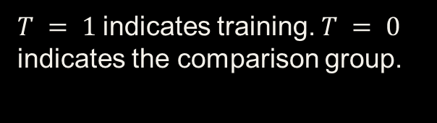
Propensity scores: the job-training question
Does job training increase earnings in 1978?
$T = 1$indicates training. $T = 0$ indicates the comparison group.
Baseline X includes demographics and earlier earnings.
Our example uses the 614-person LaLonde dataset throughout.
We need comparable people to stand in for missing counterfactual outcomes.

Slide 24
Why the observed comparison is difficult
Baseline feature | Treated | Comparison
Married | 18.9% | 51.3%
Black | 84.3% | 20.3%
1974 earnings | $2,096 | $5,619
The groups differ before training begins.

Slide 25
The high-dimensional comparison problem
We want to compare people with similar age, education, and other baseline variables.
Exact agreement on every covariate becomes difficult as X grows.
Earlier earnings are continuous, so exact matches may be rare.
A scalar treatment-assignment summary can help organize comparisons.
The propensity score summarizes assignment using the chosen covariates.

Slide 26
Definition of the propensity score
$$e(x) = P(T = 1 | X = x).$$
It is the probability of receiving training given baseline characteristics.
Every participant has a score, whether treated or untreated.
For a given x, the score concerns people sharing that baseline profile.
The observed treatment is 0 or 1. Its probability can lie between them.

Slide 27
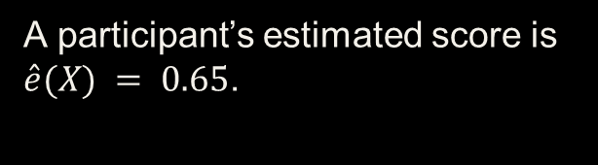
Interpreting a score
A participant’s estimated score is $\hat{e}(X) = 0.65$.
The fitted model predicts about a 65% training probability for that profile.
The participant can still appear in either treatment arm.
The score does not describe the probability of high earnings or treatment benefit.
A probability of treatment and a causal effect answer different questions.

Slide 28
The score depends on the study sample
The combined sample has 185 treated and 429 comparison participants.
The estimated assignment model describes treatment membership in these study data.
It does not automatically describe participation probabilities in the whole population.
Changing comparison sampling can change the fitted scores.
Specify the study population when interpreting a score.

Slide 29
Which variables belong in the model?
Use baseline covariates justified by the causal question and adjustment graph.
Include measured common causes of training participation and earnings.
Earlier earnings and demographic circumstances motivate the current specification.
Avoid using 1978 earnings, which is the outcome, to predict assignment.
A variable's causal role matters more than its statistical significance.

Slide 30
A logistic treatment model
$$log⁡\frac{e\left(X\right)}{1 − e\left(X\right)}= β₀ + βᵀX.$$
The model uses baseline covariates to predict binary treatment membership.
$e(X) = exp⁡(η)/\{1 + exp⁡(η)\},$where $η = β₀ + βᵀX.$
The logistic transform keeps predicted probabilities between 0 and 1.
This regression models treatment assignment, not the outcome.

Slide 31
R: estimate scores in the real dataset
library(MatchIt)
data("lalonde", package = "MatchIt")
d <- lalonde
ps_fit <- glm(treat ~ age + educ + race + married +
nodegree + re74 + re75,
family = binomial(), data = d)
d$ps <- predict(ps_fit, type = "response")
head(d[c("treat", "age", "educ", "ps")])
type = "response" returns probabilities, not log odds.

Slide 32
Fitted scores
Participant | Training | Age | Education | ê(X)
NSW1 | 1 | 37 | 11 | 0.639
NSW11 | 1 | 19 | 9 | 0.689
PSID1 | 0 | 30 | 12 | 0.026
PSID16 | 0 | 42 | 0 | 0.056
All listed scores also use race, marriage, degree status, and earlier earnings.

Slide 33
Scores differ across observed groups
Group | n | Mean score | Median score | Observed score range
Treated | 185 | 0.577 | 0.654 | 0.025–0.853
Comparison | 429 | 0.182 | 0.076 | 0.009–0.789
Estimating a propensity score does not itself change either group.

Slide 34
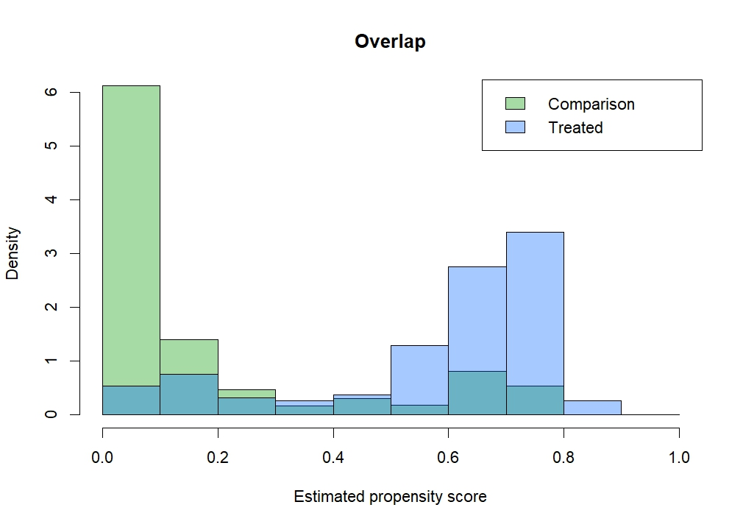
Overlap in the LaLonde data

Slide 35
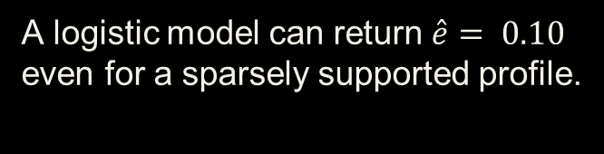
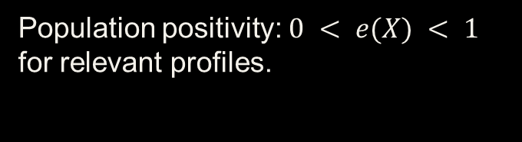
Positivity and empirical overlap
Population positivity: $0 < e(X) < 1$ for relevant profiles.
Empirical overlap: the sample contains comparable units from both arms.
A logistic model can return $\hat{e}= 0.10$ even for a sparsely supported profile.
Finite scores between 0 and 1 do not establish adequate data support.
A fitted probability cannot create missing counterfactual information.

Slide 36

The propensity score’s balancing property
For the true propensity score:
$$T ⟂ X | e(X).$$
Within a score stratum, treatment assignment does not further select the distribution of X.
This is a population statement, not exact equality between individual profiles.
Estimated scores and finite samples require diagnostic checks.
Comparable score strata can organize a fairer comparison.

Slide 37
Why the balancing property holds
Once $e(X) = s$, every profile in that stratum has treatment probability s.
$$P(T = 1 | X, e(X) = s) = s.$$
$$P(T = 1 | e(X) = s) = s.$$
Knowing X within the stratum supplies no further assignment information.
Therefore $T ⟂ X | e(X).$

Slide 38
From balance to causal identification
Assume $\{Y(1), Y(0)\} ⟂ T | X$.
Together with the true balancing score, exchangeability also holds given e(X).
Then $E[Y(t)] = Eₑ\{E[Y | T = t, e(X)]\}.$
Consistency and positivity remain necessary.
The score reduces the adjustment dimension under the causal assumptions.

Slide 39
Similar scores do not mean identical people
Different covariate profiles can produce similar treatment probabilities.
Matching on a score can leave important covariates imbalanced in a sample.
Assess age, prior earnings, and other adjustment covariates individually.
An unmeasured confounder cannot enter this score unless we measure it.
Score similarity is useful, but observed balance still needs checking.

Slide 40
Propensity-score checkpoint
What does a score of 0.65 mean for an untreated participant?
Why do the treated and comparison arms still have different mean scores?
Does a score strictly between 0 and 1 prove positivity?
What would you inspect before interpreting a matched comparison?
Estimating scores is the first step. Comparable groups require a design and balance checks.

Slide 41
Matching: a comparable job-training group
We have estimated each person's probability of receiving training.
Now select untreated participants with similar baseline profiles.
Use their earnings to inform the missing no-training comparison.
The scientific goal remains an effect in a clearly defined population.
Matching uses observed comparison people to support the counterfactual contrast.

Slide 42
Why match when we have g-computation?
Approach | How it constructs the comparison
G-computation | Predict both outcomes using an outcome model
Matching | Select comparable observed treatment and comparison units
Matching + regression | Model outcomes after constructing comparable groups
Matching is an alternative adjustment strategy, not a prerequisite for g-computation.

Slide 43
Benefits and costs of matching
Closer observed comparisons can reduce reliance on outcome extrapolation.
Balance diagnostics make the comparison design visible.
Discarding participants can reduce precision and change the target population.
Matching choices and residual covariate imbalance can affect estimates.
Matching trades sample retention against comparability.

Slide 44
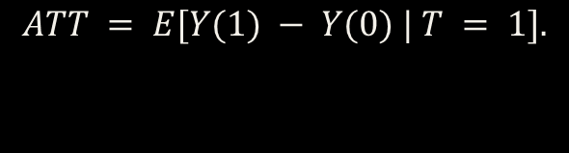
The causal target: ATT
$$ATT = E[Y(1) − Y(0) | T = 1].$$
Use treated participants as the focal group.
Find controls to represent their outcomes without training.
Dropping treated participants can change the effect being targeted.
Full ATT and the effect among retained treated participants may differ.

Slide 45
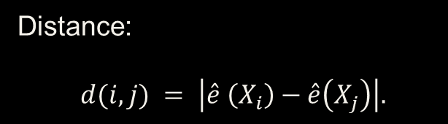

Nearest-neighbor propensity-score matching
For treated participant $i$, seek a control $j$ with a nearby score.
Distance:
$$d(i,j) = \left|\hat{e} \left(X_{i}\right)−\hat{e}\left(X_{j}\right)\right|.$$
One-to-one matching assigns one eligible control to each retained treated unit.
A greedy algorithm selects each match without optimizing the whole set.
A nearby score is a starting point. Covariate balance determines usefulness.

Slide 46
Actual pairs from the job-training data
Treated ID | Score | Comparison ID | Score | Gap
NSW178 | 0.853 | PSID118 | 0.789 | 0.064
NSW95 | 0.819 | PSID226 | 0.779 | 0.041
NSW176 | 0.816 | PSID196 | 0.764 | 0.052
These are the first three pairs when matching treated scores from largest to smallest.

Slide 47
Matching order and competition for controls
Without replacement, each control can serve only one treated unit.
Early matches remove controls from the pool for later matches.
Different matching orders can produce different pairs.
Record the order so the design is reproducible.
Our example uses descending treated scores: m.order = "largest".

Slide 48
With or without replacement
Choice | Benefit | Cost
Without replacement | Each control appears in one pair | Later treated units may receive weaker matches
With replacement | Good controls can serve multiple treated units | Reuse reduces independent information
A reused control remains one person, even if they appear in several matches.

Slide 49
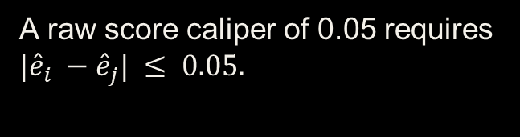
Calipers: a maximum acceptable distance
A raw score caliper of 0.05 requires $|{\hat{e}}_{i} −{\hat{e}}_{j}| ≤ 0.05.$
A treated person with no eligible control remains unmatched.
Smaller calipers can prevent weak matches but discard more participants.
A caliper can instead be defined on log odds or in SD units.
The number 0.05 has meaning only after specifying the distance scale.

Slide 50
R: the initial matching design
library(MatchIt)
data("lalonde", package = "MatchIt")
d <- lalonde
f <- treat ~ age + educ + race + married +
nodegree + re74 + re75
m0 <- matchit(f, data = d, method = "nearest",
distance = "glm", estimand = "ATT",
ratio = 1, replace = FALSE,
m.order = "largest")
summary(m0)
Outcome earnings do not enter the matching formula.

Slide 51
Who remains after initial matching?
Group | Before | After
Treated | 185 | 185
Comparison | 429 | 185
Unused comparison participants | 0 | 244
All treated participants remain, but retention does not establish adequate balance.

Slide 52

Covariate balance: standardized differences
SMD =
(treated mean − comparison mean)/sref.
Use a fixed reference scale when comparing designs.
Here sref is the SD in the original treated group.
Inspect each adjustment covariate. $|SMD| < 0.10$is a guideline.
A small score difference does not guarantee small covariate differences.

Slide 53
Initial matching improves some covariates
Covariate | Before |SMD| | After |SMD|
Age | 0.309 | 0.072
Married | 0.824 | 0.055
1974 earnings | 0.721 | 0.050
Black indicator | 1.757 | 1.023
Substantial imbalance remains. We should revise the design before relying on its effect estimate.

Slide 54
R: add a raw-score caliper
m1 <- matchit(f, data = d, method = "nearest",
distance = "glm", estimand = "ATT",
ratio = 1, replace = FALSE,
m.order = "largest",
caliper = 0.05, std.caliper = FALSE)
summary(m1)
plot(summary(m1), abs = TRUE)
This caliper limits probability differences to 0.05.

Slide 55
Caliper matching changes the analysis sample
Group | Initial match | 0.05 caliper
Treated retained | 185 | 113
Comparison retained | 185 | 113
Treated unmatched | 0 | 72
The caliper design represents retained treated participants, not automatically all 185.

Slide 56
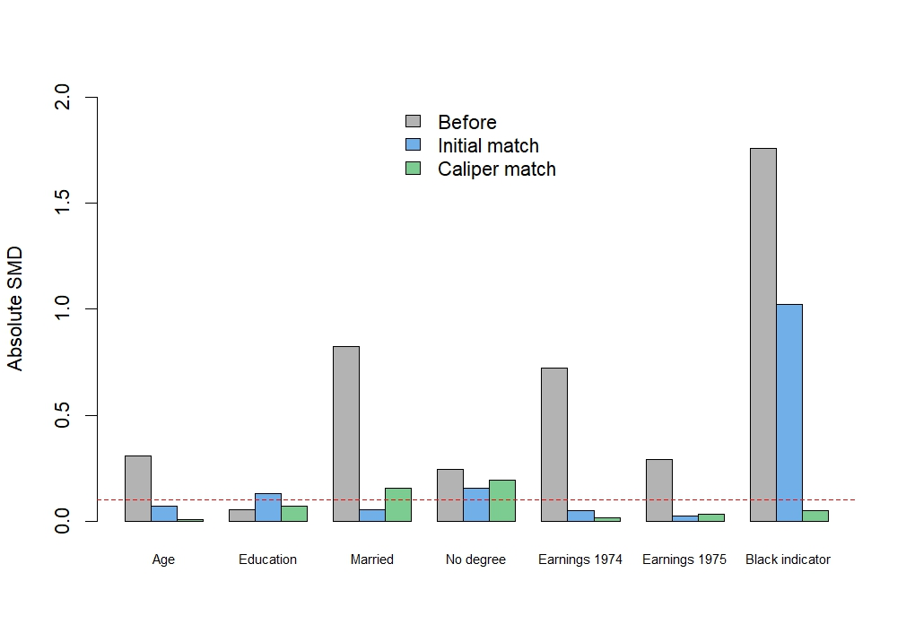
Balance across matching designs
The caliper improves some imbalances, but degree status and marriage still need attention.

Slide 57
If balance is still poor
Revise nonlinear terms or interactions in the propensity model.
Consider exact matching on scientifically important variables.
Consider replacement, a different distance, or a different matching method.
Reassess retention and the target population after each design change.
Improve the comparison using diagnostics, not the size or sign of the estimated effect.

Slide 58
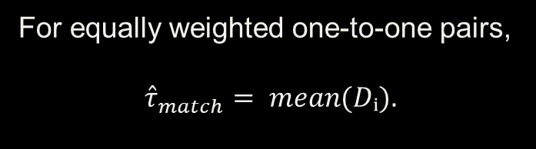
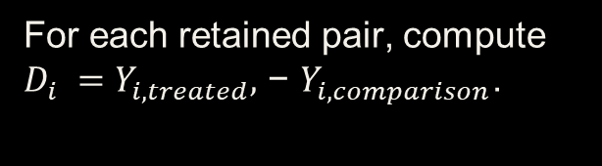
The matched outcome contrast
For each retained pair, compute $D_{i} =Y_{i,treated},$ − $Y_{i,comparison}$.
For equally weighted one-to-one pairs,
$${\hat{τ}}_{match}= mean(Dᵢ).$$
This equals the difference in matched-arm means.
A causal interpretation still requires adequate adjustment and support.
Pairing supplies a comparison. Assumptions justify treating it causally.

Slide 59
R: compute the matched point estimate
md <- match.data(m1)
mu1 <- with(md, weighted.mean(re78[treat == 1],
weights[treat == 1]))
mu0 <- with(md, weighted.mean(re78[treat == 0],
weights[treat == 0]))
matched_difference <- mu1 - mu0
matched_difference
Keep the point estimate separate from the inference step.

Slide 60
Results depend on design and population
Analysis | Observed earnings contrast | Population represented
Crude full-sample | About −$635 | Original observed groups
Initial nearest match | About +$894 | All treated participants
0.05-caliper match | About +$1,433 | 113 retained treated participants
The change in estimates is not proof that the final design has removed confounding.

Slide 61
Uncertainty and remaining assumptions
Matched observations require an analysis that respects the matching structure.
Control reuse and unequal weights require additional care.
Standard resampling is not universally valid for nearest-neighbor estimators.
No matching method removes unmeasured confounding or absent support.
A credible report includes uncertainty, balance, retention, and causal limitations.

Slide 62
Matching: Summary
Matching and g-computation offer different ways to use a valid adjustment set.
Scores organize comparisons, while covariate diagnostics assess the resulting design.
Calipers can improve comparability while changing the represented population.
Outcome estimates become meaningful only after design and assumption checks.
Next: weighting lets us change contributions rather than selecting pairs.

